Slide 1
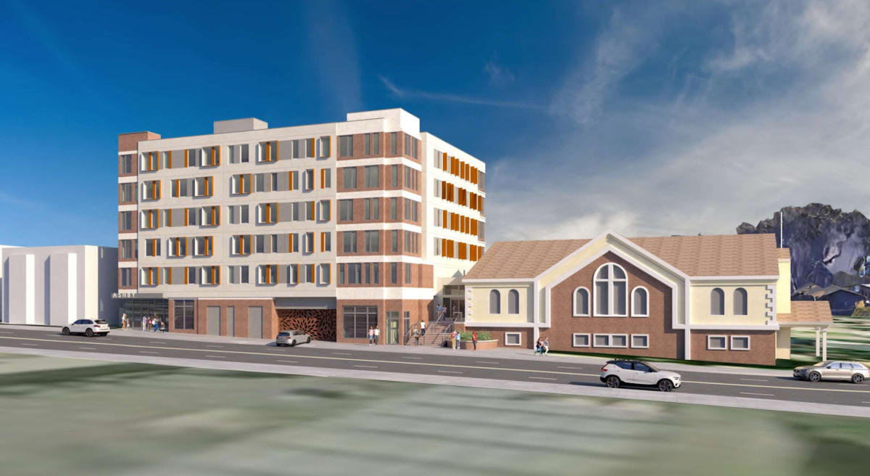
Measure W Home Together Fund: Ephesian Legacy Court
PRE-DEVELOPMENT
Ephesian Legacy Court Apartments consists of 80 housing units with 79 units serving low-income senior households. Forty (40) units will be reserved for households experiencing homelessness.
Location: 1708 Harmon Street, Berkeley
Developer: Community Housing Development Corporation | Architect: Kodama Diseno Architects
Home Together Capital Funding: | $7,000,000 | Construction Start: | February 2026
Home Together Operations Funding: | $0 | Completion: | August 2027
Other County Funding: | $0 | Residential Development Cost: | $75,539,809
City Match: | $18,087,701 | Per Unit Cost: | $944,248
Permanent Financing Sources (updated 12/8/2025) | Amount | % of Total
Home Together Fund | $7,000,000 | 9.3%
Permanent Mortgage | $4,455,000 | 5.9%
State HCD Multifamily Housing Program | $18,718,944 | 24.8%
City of Berkeley Measure O | $14,531,301 | 19.2%
City of Berkeley Housing Trust Fund | $3,556,400 | 4.7%
Deferred Developer Fee | $1,700,000 | 2.2%
General Partner Equity | $1,000,000 | 1.3%
4% LIHTC Equity | $24,578,164 | 32.5%
Total Sources | $75,539,809 | 100%
Total Project Unit Mix Affordability Levels
Income Level | 1-Bd | 2-Bd | Total Units
30% AMI | 40 |  | 40
40% AMI | 12 |  | 12
50% AMI | 27 |  | 27
Manager |  | 1 | 1
Total | 79 | 1 | 80
Total Project Unit by Target Population | Units
Homeless Seniors | 40
Low-Income Seniors | 39
Total | 79
as of February 2026

Slide 2
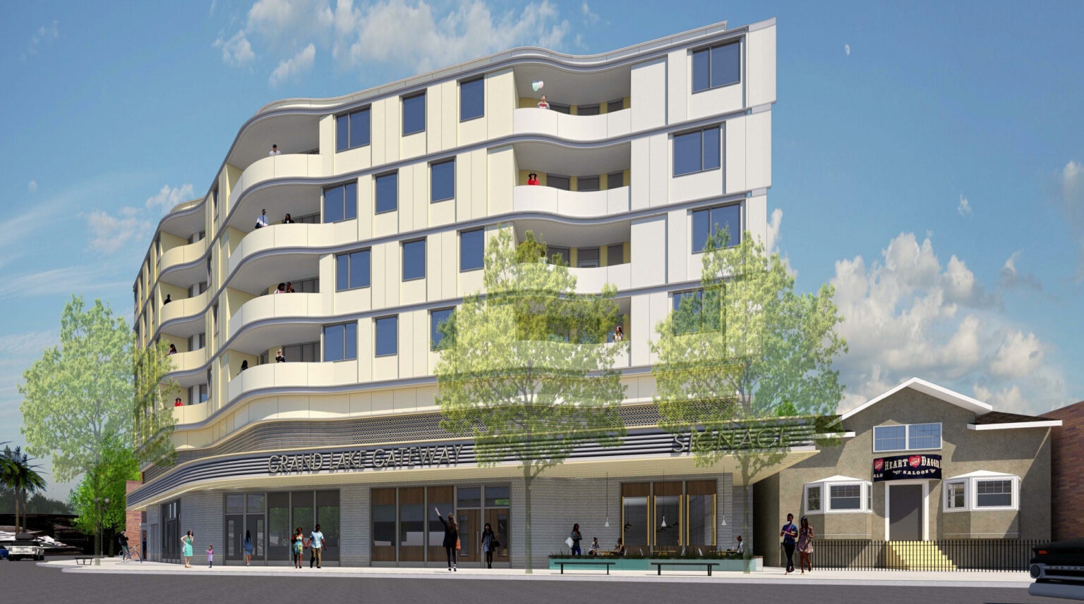
Measure W Home Together Fund: 500 Lake Park Apartments
PRE-DEVELOPMENT
500 Lake Park Apartments consists of 53 housing units with 52 units serving low-income households and ground floor retail. Twenty (20) units will be reserved for homeless veterans.
Location: 500 Lake Park Avenue, Oakland
Developer: EAH Housing | Architect: Lowney Architecture
Home Together Capital Funding: | $3,200,000 | Construction Start: | December 2026
Home Together Operations Funding: | $450,000 | Completion: | December 2028
Other County Funding: | $0 | Total Development Cost: | $74,223,216
City Match: | $28,771,000 | Per Unit Cost: | $1,400,438
Permanent Financing Sources (updated 12/8/2025) | Amount | % of Total
Home Together Fund Capital | $3,200,000 | 4%
Home Together Fund Operations | $450,000 | 0.6%
City of Oakland | $28,771,000 | 35.9%
Oakland Housing Authority Land Donation | $4,900,000 | 6.1%
Oakland Housing Authority Permanent Loan | $2,600,000 | 3.2%
State HCD Veterans Housing and Homelessness Prevention Program | $3,528,887 | 4.4%
State HCD Infill Infrastructure Grant Program | $4,154,768 | 5.2%
Deferred Developer Fee and GP Equity | $800,000 | 1%
9% LIHTC Equity | $31,626,453 | 39.5%
Total Sources | $80,031,108 | 100%
Total Project Unit Mix Affordability Levels
Income Level | Studio | 1-Bd | 2-Bd | 3-Bd | Total Units
30% AMI | 1 | 14 | 4 | 3 | 22
40% AMI |  | 3 | 6 | 7 | 16
50% AMI |  | 3 | 1 | 1 | 5
60% AMI |  | 4 | 2 | 3 | 9
Manager |  |  | 1 |  | 1
Total | 1 | 24 | 14 | 14 | 53
Total Project Unit by Target Population | Units
Homeless Veterans | 20
Low-Income Households | 32
Total | 52
Units @ 20% AMI:
Twenty (20) units will be restricted to households with incomes at or below 20% Area Median Income.
as of February 2026

Slide 3
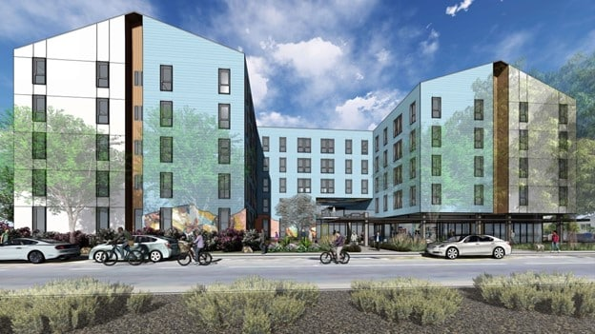
Measure W Home Together Fund: Brighter Bancroft Senior
PRE-DEVELOPMENT
Brighter Bancroft Senior Apartments consists of 91 housing units with 90 units serving low-income households. Twenty-five (25) units will be reserved for homeless households.
Location: 2500 76th Avenue, Oakland
Developer: Eden Housing | Architect: BAR Architect & Interiors
Home Together Capital Funding: | $4,375,000 | Construction Start: | January 2027
Home Together Operations Funding: | $0 | Completion: | July 2028
Other County Funding: | $0 | Residential Development Cost: | $81,607,414
City Match: | $15,000,000 | Per Unit Cost: | $896,785
Permanent Financing Sources (updated 12/8/2025) | Amount | % of Total
Home Together Fund Capital | $4,375,000 | 5.4%
Permanent Mortgage | $8,408,000 | 10.3%
City of Oakland Measure U | $15,000,000 | 18.4%
Oakland Housing Authority | $10,000,000 | 12.2%
Affordable Housing Program | $2,000,000 | 2.4%
Deferred Developer Fee | $812,811 | 1%
GP Equity | $6,505,983 | 8%
4% LIHTC Equity | $34,505,620 | 42.3%
Total Sources | $81,607,414 | 100%
Total Project Unit Mix Affordability Levels
Income Level | 1-Bd | 2-Bd | Total Units
30% AMI | 25 | 4 | 29
40% AMI | 13 | 4 | 17
50% AMI | 37 | 7 | 44
Manager |  | 1 | 1
Total | 75 | 16 | 91
Total Project Unit by Target Population | Units
Homeless Households | 25
Low-Income Households | 65
Total | 90
as of February 2026

Slide 4
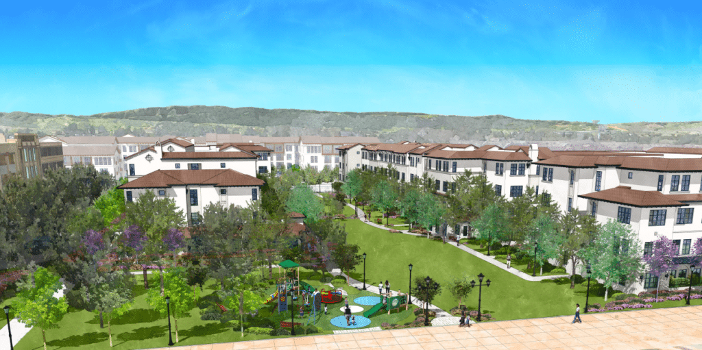
Measure W Home Together Fund: Downtown Livermore Apartments
PRE-DEVELOPMENT
Downtown Livermore Apartments consists of 130 housing units with 128 units serving low-income households. Twenty-three (23) units will be reserved for homeless households and ten (10) units will be reserved for persons with physical, mental, or developmental disabilities.
Location: Railroad Avenue and South L Street, Livermore
Developer: Eden Housing | Architect: Dahlin Group
Home Together Capital Funding: | $6,100,000 | Construction Start: | November 2026
Home Together Operations Funding: | $0 | Completion: | July 2028
Other County Funding: | $14,402,382 | Total Development Cost: | $126,953,539
City Match: | $9,226,335 | Per Unit Cost: | $976,566
Permanent Financing Sources (updated 12/8/2025) | Amount | % of Total
Home Together Fund Capital | $6,100,000 | 4.8%
Perm Loan | $19,372,576 | 15.2%
City of Livermore | $9,226,335 | 7.3%
Alameda County Measure A1 | $14,402,382 | 11.3%
State HCD No Place Like Home Program | $6,400,000 | 5%
State HCD National Housing Trust Fund Program | $15,382,421 | 12.1%
State HCD Neighborhood Stabilization Program | $5,000,000 | 3.9%
Deferred Developer Fee | $11,435,056 | 9%
Accrued Deferred Interest | $1,351,085 | 1%
SLD Lawsuit Bond | $500,000 | 0.4%
4% LIHTC Equity | $37,783,684 | 29.7%
Total Sources | $126,953,539 | 100%
Total Project Unit by Target Population | Units
Homeless Households | 23
Physical, Mental, or Intellectual Disabilities | 10
Low-Income Households | 95
Total | 128
Total Project Unit Mix Affordability Levels
Income Level | 1-Bd | 2-Bd | 3-Bd | Total Units
20% AMI | 6 | 6 | 5 | 17
30% AMI | 14 | 4 | 2 | 20
50% AMI | 11 | 25 | 14 | 50
60% AMI | 10 | 19 | 12 | 41
Manager |  | 2 |  | 2
Total | 41 | 56 | 33 | 130
Units @ 20% AMI:
Seventeen (17) units will be restricted to households with incomes at or below 20% Area Median Income.
as of February 2026

Slide 5
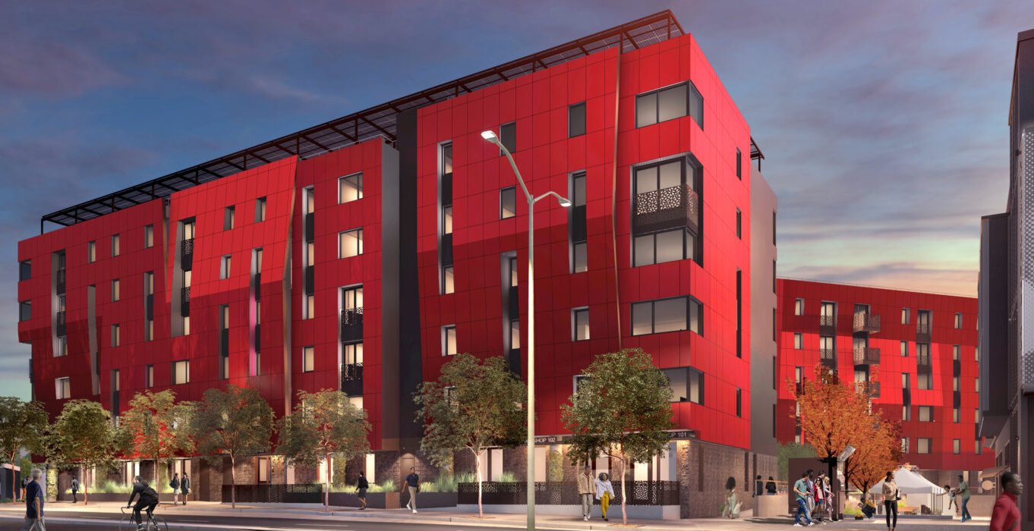
Measure W Home Together Fund: The Residences at Liberation Park
PRE-DEVELOPMENT
The Residents at Liberation Park consists of 119 housing units with 118 units serving low-income households and ground floor retail. Thirty (30) units will be reserved for homeless households.
Location: 2751 73rd Avenue and 7101 MacArthur Boulevard, Oakland
Developer: Black Cultural Zone and Eden Housing | Architect: YA Studios
Home Together Capital Funding: | $4,674,667 | Construction Start: | June 2026
Home Together Operations Funding: | $2,075,333 | Completion: | February 2028
Other County Funding: | $0 | Residential Development Cost: | $137,078,310
City Match: | $28,000,000 | Per Unit Cost: | $1,151,919
Permanent Financing Sources (updated 12/8/2025) | Amount | % of Total
Home Together Fund Capital | $4,674,667 | 3.4%
Home Together Fund Operations | $2,075,333 | 1.5%
State HCD Affordable Housing and Sustainable Communities Program | $35,000,000 | 25.5%
City of Oakland Measure U | $28,000,000 | 20.4%
State HCD Infill Infrastructure Grant Program | $7,767,171 | 5.7%
Accrued Soft Loan Interest | $1,631,254 | 1.2%
4% LIHTC Equity | $57,929,885 | 42.3%
Total Sources | $137,078,310 | 100%
Total Project Unit Mix Affordability Levels
Income Level | Studio | 1-Bd | 2-Bd | 3-Bd | Total Units
20% AMI | 5 | 9 | 5 |  | 19
30% AMI | 5 | 10 | 6 | 3 | 24
40% AMI |  | 11 | 6 | 8 | 25
50% AMI |  | 7 | 8 | 14 | 29
60% AMI |  | 7 | 8 | 6 | 21
Manager |  |  |  | 1 | 1
Total | 10 | 44 | 33 | 32 | 119
Total Project Unit by Target Population | Units
Homeless | 30
Low-Income Households | 88
Total | 118
Units @ 20% AMI:
Thirty (30) units will be restricted to households with incomes at or below 20% Area Median Income.
as of February 2026

Slide 6
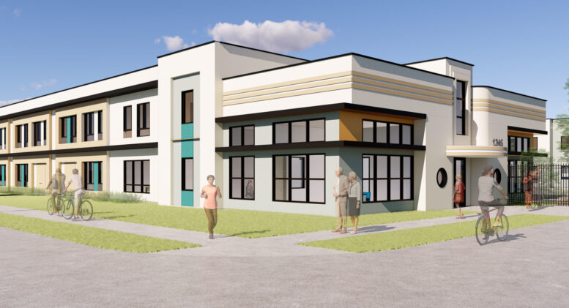
Measure W Home Together Fund: 1247 McKay
PRE-DEVELOPMENT
1247 McKay consists of 107 housing units with 106 units serving low-income households and ground floor retail. One hundred and six (106) units will be reserved for homeless seniors.
Location: 1247 McKay Avenue, Alameda
Developer: Mercy Housing California | Architect: PYATOK
Home Together Capital Funding: | $5,500,000 | Construction Start: | November 2026
Home Together Operations Funding: | $0 | Completion: | April 2028
Other County Funding: | $6,926,828 | Residential Development Cost: | $77,243,662
City Match: | $778,654 | Per Unit Cost: | $721,903
Permanent Financing Sources (updated 12/8/2025) | Amount | % of Total
Home Together Fund Capital | $5,500,000 | 7.1%
HUD 202 Capital Grant | $12,070,000 | 15.6%
Alameda County Measure A1 | $6,926,828 | 9%
State Health and Human Services Community Care Expansion Grant | $10,964,423 | 14.2%
Fergeson Foundation Grant | $6,000,000 | 7.8%
City of Alameda HOME/CDBG | $778,654 | 1%
GP – Year 1 PRAC | $1,008,378 | 1.3%
9% LIHTC Equity | $33,995,379 | 44%
Total Sources | $77,243,662 | 100%
Total Project Unit Mix Affordability Levels
Income Level | Studio | 2-Bd | Total Units
20% AMI | 36 |  | 36
30% AMI | 70 |  | 70
Manager |  | 1
Total | 106 | 1 | 107
Total Project Unit by Target Population | Units
Homeless Senior Households | 106
Total | 106
Units @ 20% AMI:
Thirty-six (36) units will be restricted to households with incomes at or below 20% Area Median Income.
as of February 2026

Slide 7
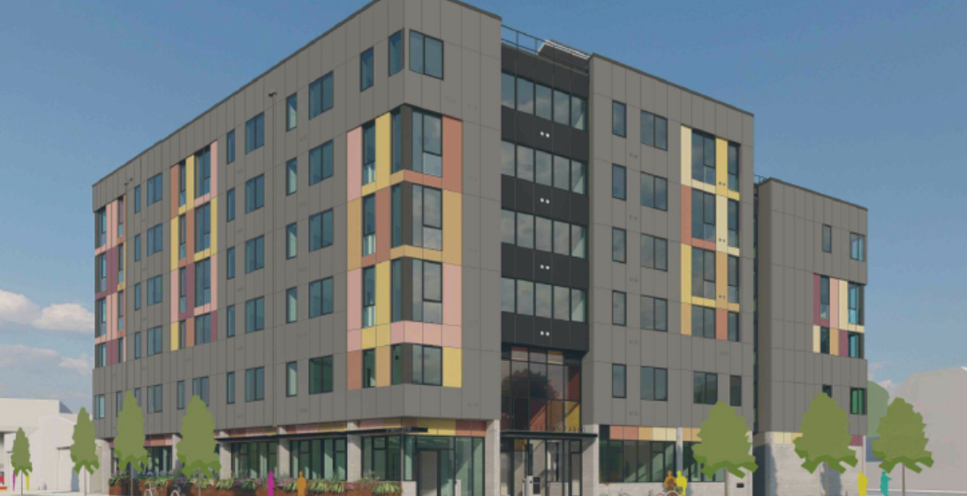
Measure W Home Together Fund: 3135 San Pablo
PRE-DEVELOPMENT
3135 San Pablo consists of 74 housing units with 73 units serving low-income senior households. Twenty-five (25) units will be reserved for homeless households.
Location: 3135 San Pablo Avenue and 967 32nd Street, Oakland
Developer: Satellite Affordable Housing Associates | Architect: Leddy Maytum Stacy Architects
Home Together Capital Funding: | $4,375,000 | Construction Start: | October 2026
Home Together Operations Funding: | $1,250,000 | Completion: | May 2028
Other County Funding: | $0 | Residential Development Cost: | $71,155,817
City Match: | $22,111,927 | Per Unit Cost: | $974,737
Permanent Financing Sources (updated 12/8/2025) | Amount | % of Total
Home Together Fund Capital | $4,375,000 | 5.8%
Home Together Fund Operations | $1,250,000 | 1.7%
City of Oakland | $22,111,927 | 29.6%
Oakland Housing Authority | $10,000,000 | 13.4%
State of California Sponsor Loan | $12,000,000 | 16%
Local Initiatives Support Corporation Grant | $156,000 | 0.2%
Sponsor Loan Interest and GP Equity | $970,602 | 1.3%
9% LIHTC Equity | $23,876,406 | 31.9%
Total Sources | $74,739,935 | 100%
Total Project Unit Mix Affordability Levels
Income Level | Studio | 1-Bd | 2-Bd | Total Units
20% AMI | 12 | 4 |  | 16
30% AMI | 20 |  |  | 20
50% AMI | 23 |  |  | 23
60% AMI |  | 13 |  | 13
Manager |  |  | 1 | 1
Total | 55 | 17 | 1 | 73
Total Project Unit by Target Population | Units
Homeless | 25
Low-Income Households | 48
Total | 73
Units @ 20% AMI:
Twenty-five (25) units will be restricted to households with incomes at or below 20% Area Median Income.
as of February 2026

Slide 8
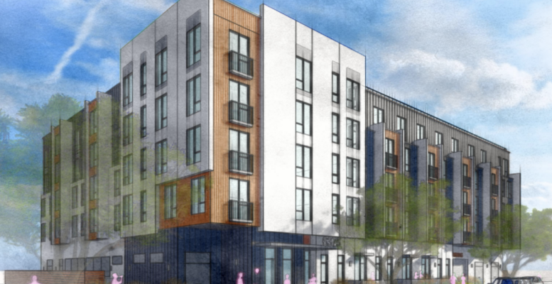
Measure W Home Together Fund: Thornton Avenue Family Apartments
PRE-DEVELOPMENT
Thornton Avenue Family Apartments consists of 59 housing units with 58 units serving low-income households. Thirteen (13) units will be reserved for homeless households, and forty-six (46) units will be reserved for families.
Location: 6347-6371 Thornton Avenue, Newark
Developer: Satellite Affordable Housing Associates | Architect: Van Meter Williams Pollack, LLP
Home Together Capital Funding: | $2,375,000 | Construction Start: | March 2027
Home Together Operations Funding: | $550,000 | Completion: | September 2028
Other County Funding: | $0 | Total Development Cost: | $55,489,321
City Match: | $8,523,743 | Per Unit Cost: | $946,599
Permanent Financing Sources (updated 12/8/2025) | Amount | % of Total
Home Together Fund Capital | $2,375,000 | 4.2%
Home Together Fund Operations | $550,000 | 1%
City of Newark | $8,523,743 | 15.3%
City Land Donation | $4,700,000 | 8.4%
Additional Local Sources and GP Equity | $7,925,578 | 14.2%
Federal Home Loan Bank | $1,770,000 | 3.2%
9% LIHTC Equity | $30,005,000 | 53.7%
Total Sources | $55,849,321 | 100%
Total Project Unit Mix Affordability Levels
Income Level | 1-Bd | 2-Bd | 3-Bd | Total Units
30% AMI | 9 | 4 | 2 | 15
50% AMI | 11 | 6 | 6 | 23
60% AMI | 8 | 5 | 7 | 20
Manager |  |  | 1 | 1
Total | 28 | 15 | 16 | 59
Total Project Unit by Target Population | Units
Homeless | 13
Low-Income Households | 45
Total | 58
as of February 2026

Slide 9
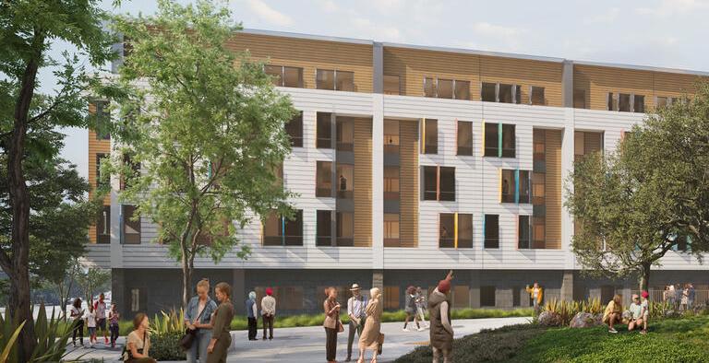
Measure W Home Together Fund: People’s Park Supportive Housing
PRE-DEVELOPMENT
People’s Park Supportive Housing consists of 110 housing units with 109 units serving low-income households. Forty-six (46) units will be reserved for homeless households and those with physical, mental, or developmental disabilities.
Location: 2556 Haste Street, Berkeley
Developer: Satellite Affordable Housing Associates | Architect: Leddy Maytum Stacy Architects
Home Together Capital Funding: | $8,050,000 | Construction Start: | June 2027
Home Together Operations Funding: | $0 | Completion: | December 2027
Other County Funding: | $0 | Total Development Cost: | $68,083,955
City Match: | $14,359,593 | Per Unit Cost: | $618,945
Permanent Financing Sources (updated 12/8/2025) | Amount | % of Total
Home Together Fund Capital | $8,050,000 | 11.8%
State of California No Place Like Home Program | $16,685,218 | 24.5%
City of Berkeley | $14,359,953 | 21.1%
Federal Home Loan Bank | $2,000,000 | 2.9%
Deferred Developer Fee | $1,500,000 | 2.2%
4% LIHTC Equity | $25,489,144 | 37.4%
Total Sources | $68,083,955 | 100%
Total Project Unit Mix Affordability Levels
Income Level | Studio | 1-Bd | 2-Bd | Total Units
15% AMI | 24 | 22 |  | 46
40% AMI | 10 |  |  | 10
50% AMI | 22 |  |  | 22
60% AMI |  | 31 |  | 31
Manager |  |  | 1 | 1
Total | 56 | 53 | 1 | 110
Total Project Unit by Target Population | Units
Homeless | 46
Low-Income Households | 53
Total | 109
Units @ 20% AMI:
Forty-Six (46) units will be restricted to households with incomes at or below 20% Area Median Income.
as of February 2026

Slide 10
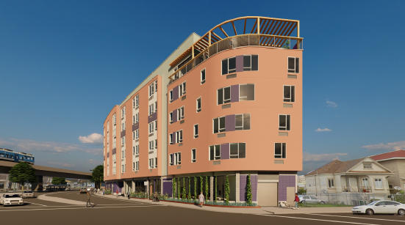
Measure W Home Together Fund: East 12th Circle
PRE-DEVELOPMENT
East 12th Circle consists of 68 housing units with 67 units serving low-income households. Seventeen (17) units will be reserved for homeless households and persons with disabilities.
Location: 1221-1223 33rd Avenue, Oakland
Developer: The Unity Council | Architect: PYATOK
Home Together Capital Funding: | $2,975,000 | Construction Start: | March 2027
Home Together Operations Funding: | $0 | Completion: | October 2028
Other County Funding: | $0 | Total Development Cost: | $58,478,165
City Match: | $10,000,000 | Per Unit Cost: | $859,973
Permanent Financing Sources (updated 12/8/2025) | Amount | % of Total
Home Together Fund Capital | $2,975,000 | 5.1%
Bay Area Housing Innovation Fund | $10,997,116 | 18.8%
City of Oakland | $10,000,000 | 17.1%
Self Help Ventures Fun | $2,543,696 | 4.3%
GP Sponsor Equity | $6,057,892 | 10.3%
Impact Fee Waivers | $1,877,960 | 3.2%
4%LIHTC Equity | $24,224,500 | 41.4%
Total Sources | $58,478,164 | 100%
Total Project Unit Mix Affordability Levels
Income Level | 1-Bd | 2-Bd | Total Units
30% AMI | 17 |  | 17
40% AMI | 7 |  | 7
50% AMI | 7 |  | 7
60% AMI | 33 | 3 | 36
Manager |  | 1 | 1
Total | 64 | 4 | 68
Total Project Unit by Target Population | Units
Homeless | 17
Low-Income Households | 50
Total | 67
as of February 2026

